Slide 1
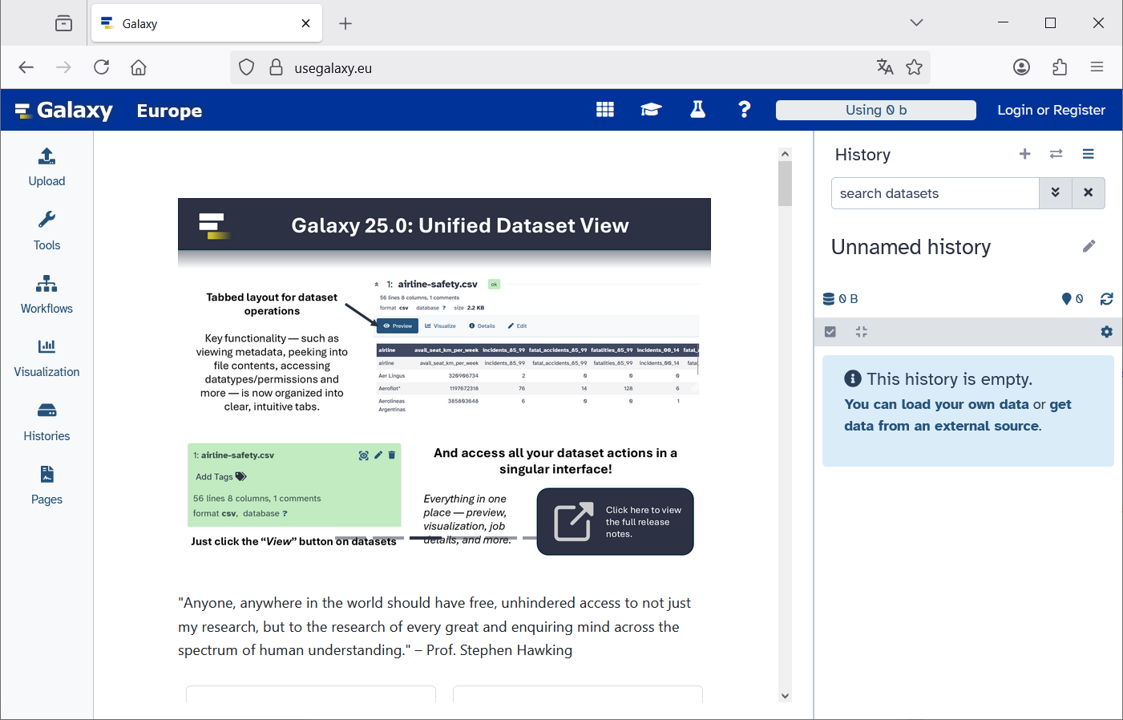
https://usegalaxy.eu
Login or register

Slide 2
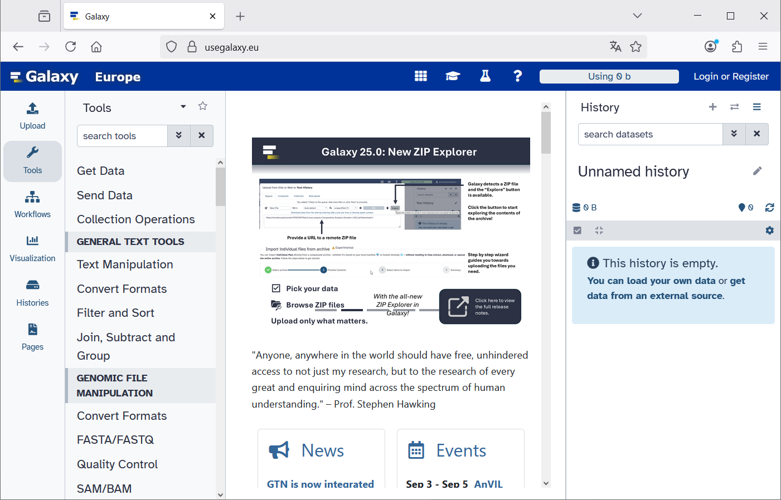
History
Center Panel
Tools
Activity Bar

Slide 3
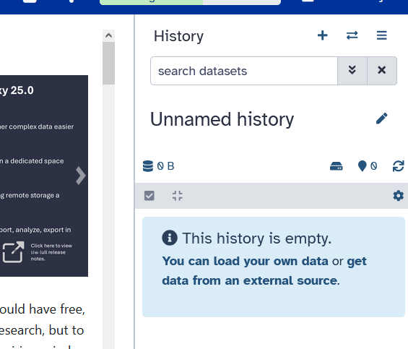
Click on „+“ to create
a new history

Slide 4
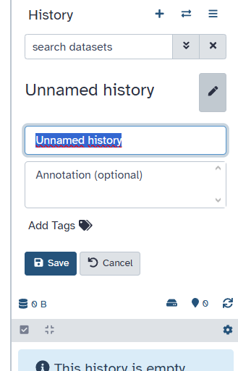
1. Click on Pen to edit the name of the new history
2. Type new name:
Data NCBI
3. Save

Slide 5
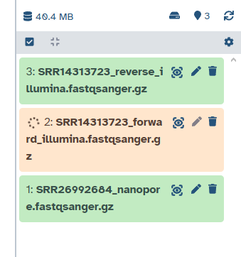
Green: File is ready
Orange: File is being processed

Slide 6
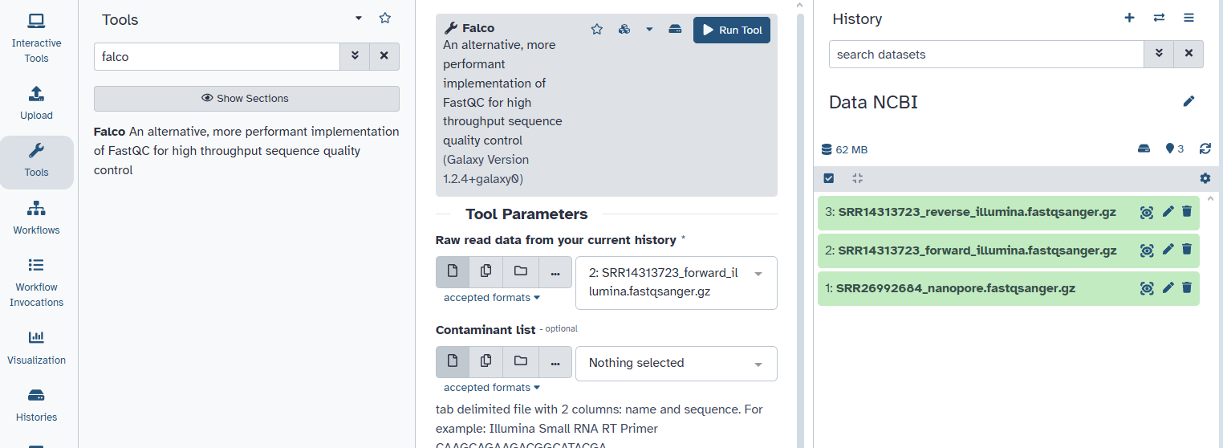
5. Click on „Run Tool“
2. Type „falco“
1. Click on Tools
3. Click on the tool
4. Chose only the Illumina forward file.

Slide 7
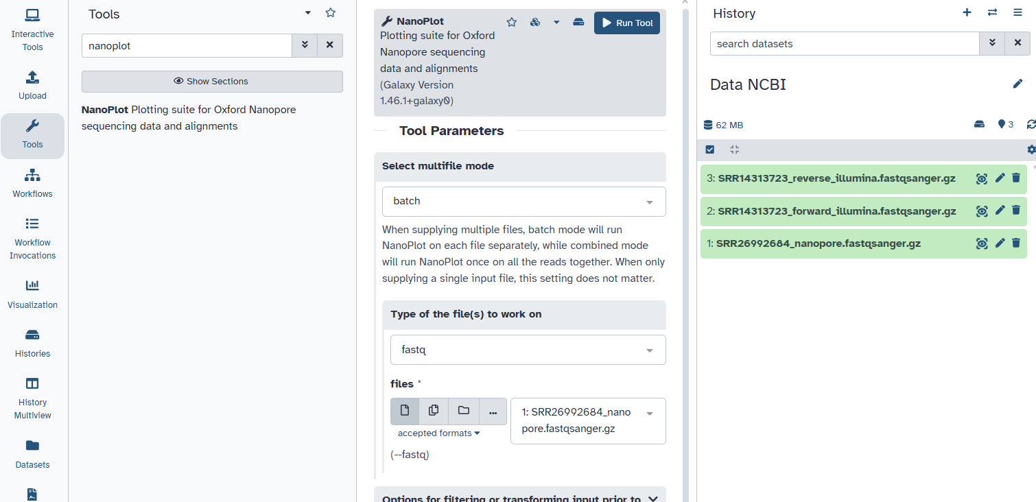
5. Click on „Run Tool“
2. Type „nanoplot“
3. Click on the tool
1. Click on Tools
4. Chose only the Nanopore file.

Slide 8
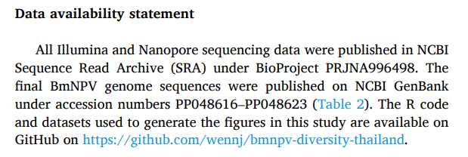

Slide 9
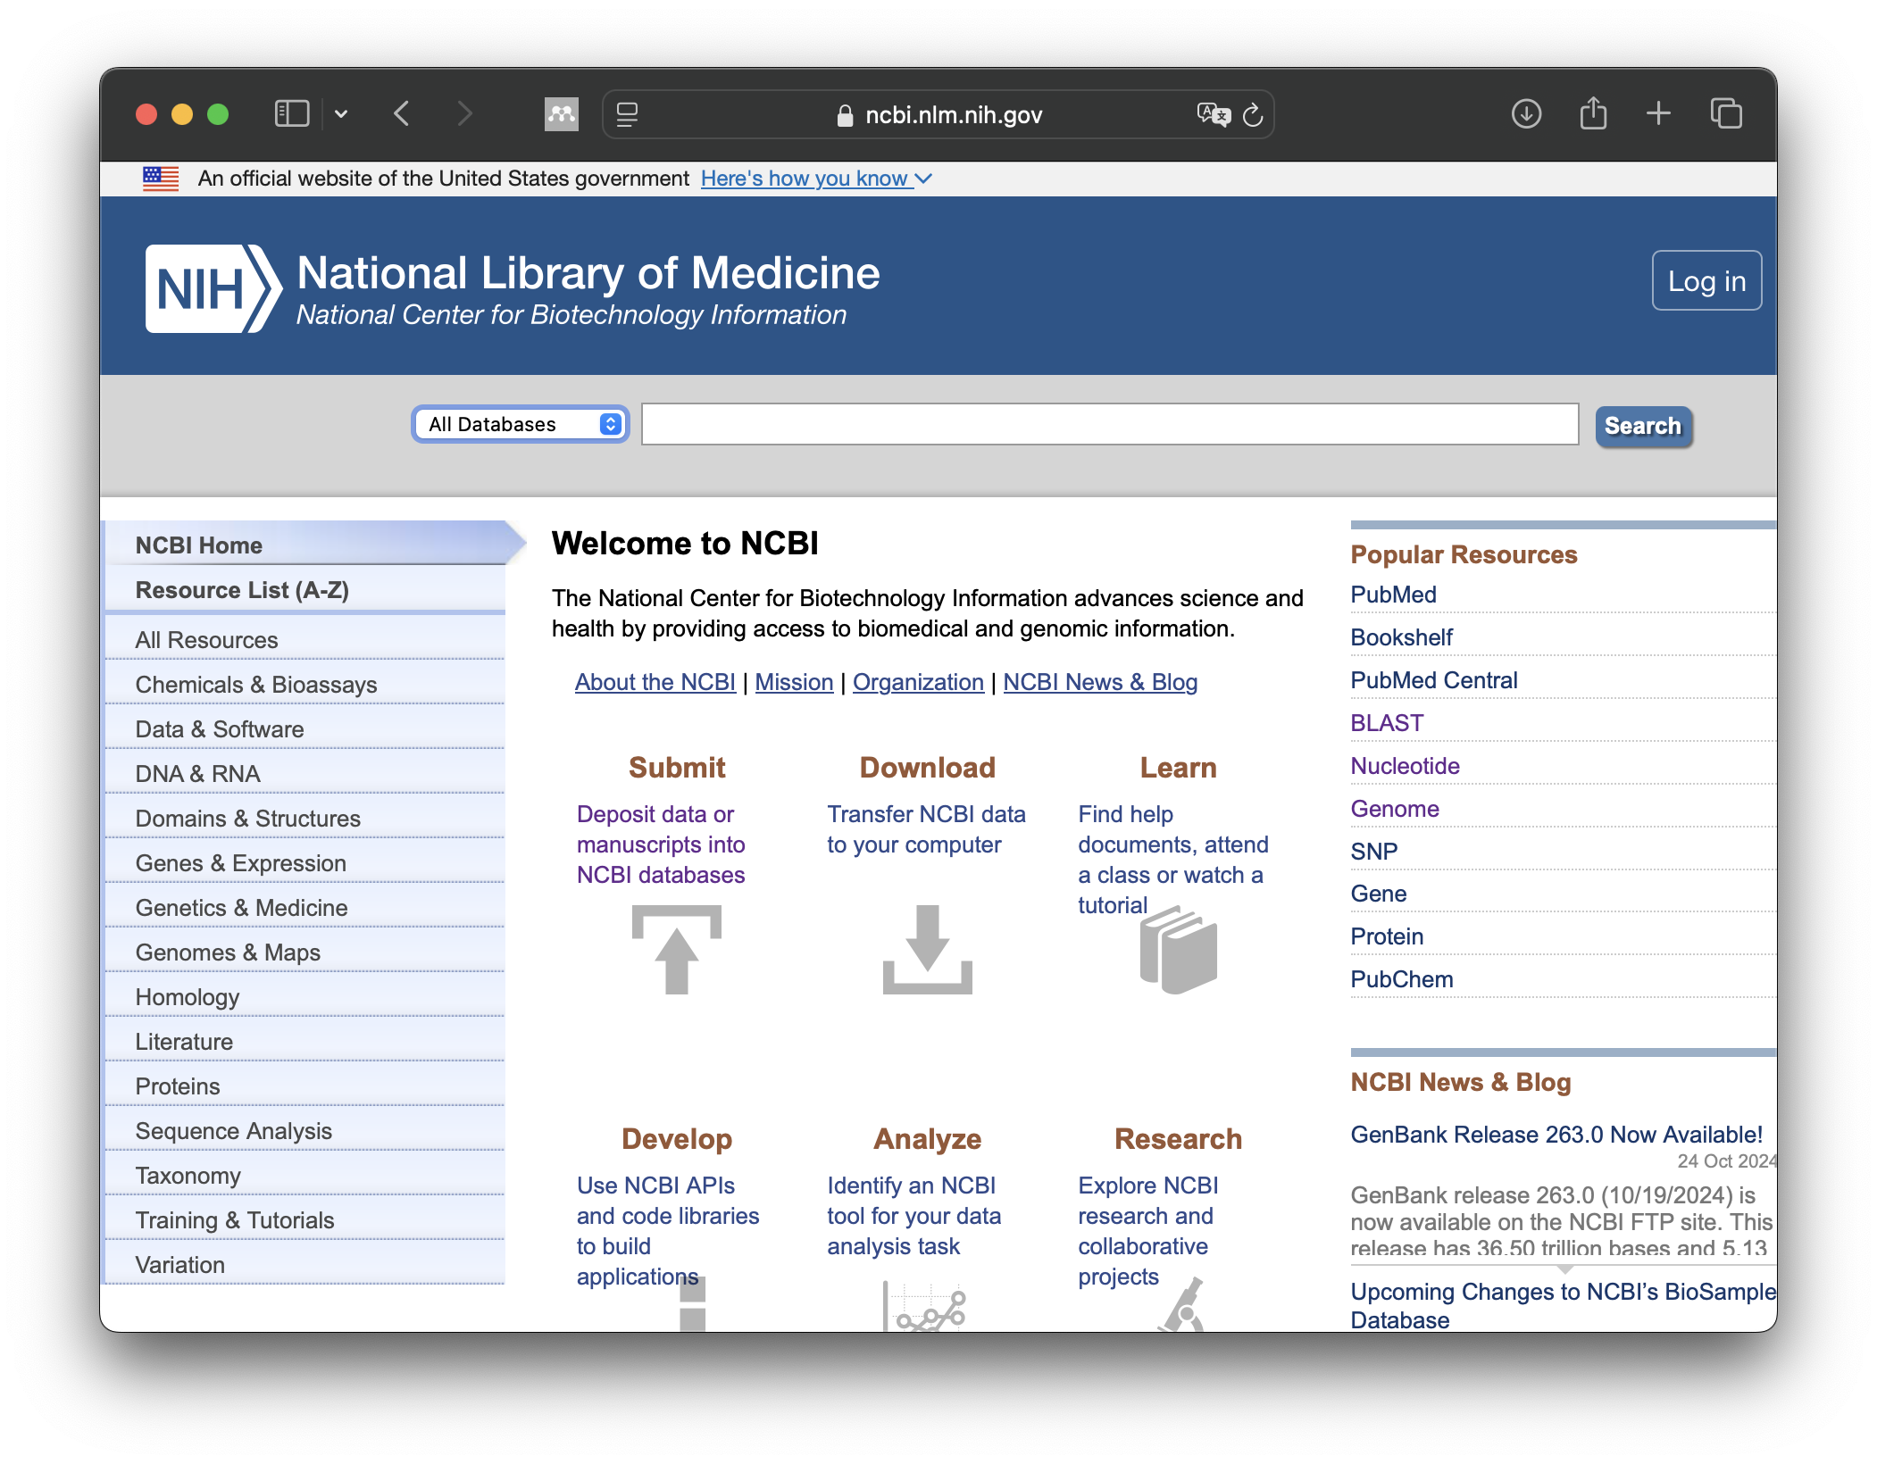
https://www.ncbi.nlm.nih.gov

Slide 10
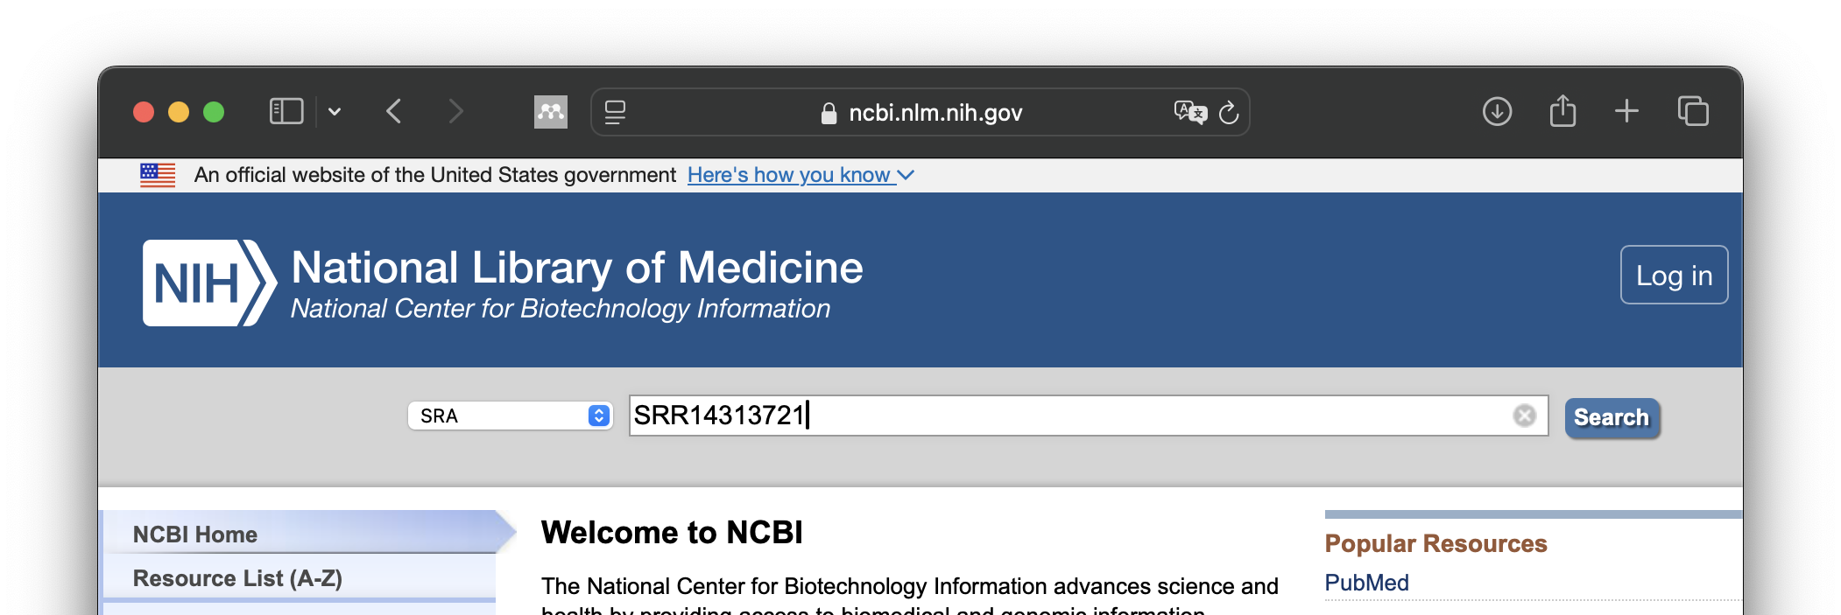
3. Click „Search“
1. Chose SRA
2. Type your search item

Slide 11
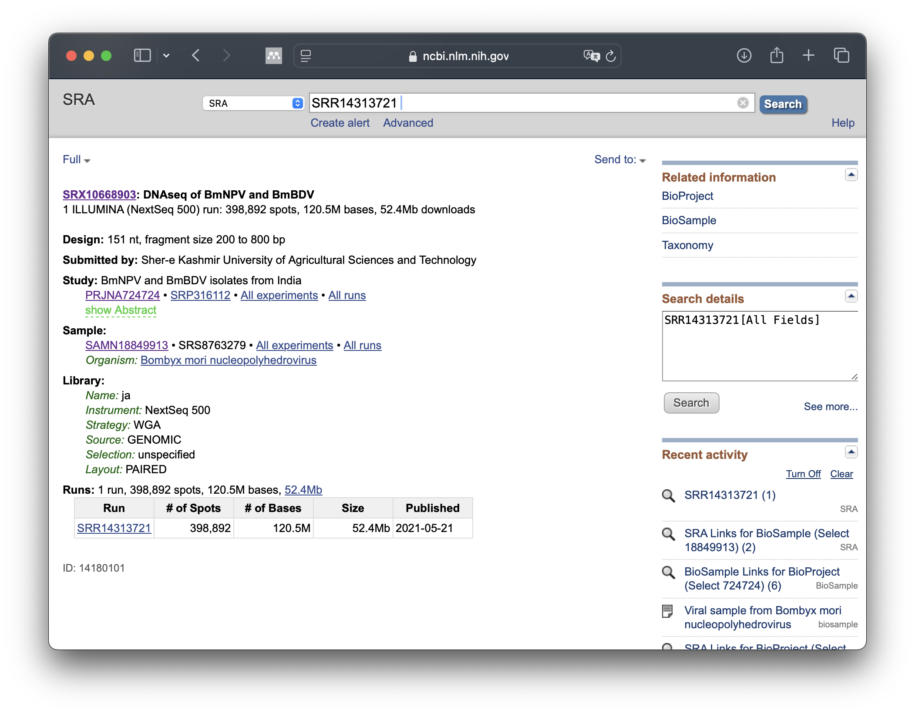
What information can you find?
Click on SRR14313721

Slide 12
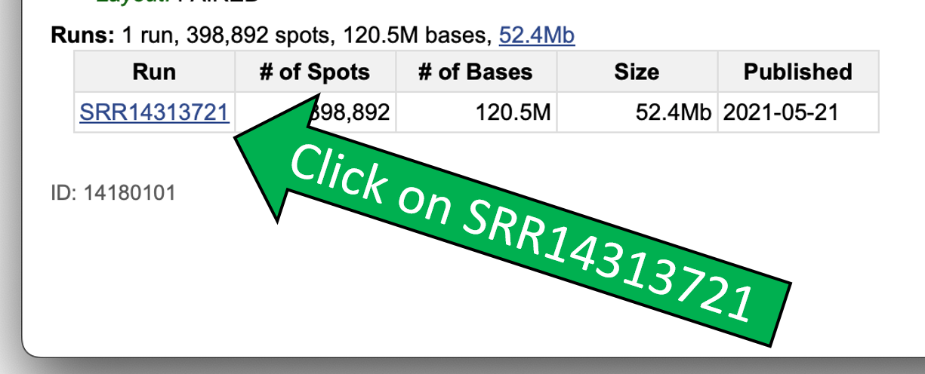

Slide 13
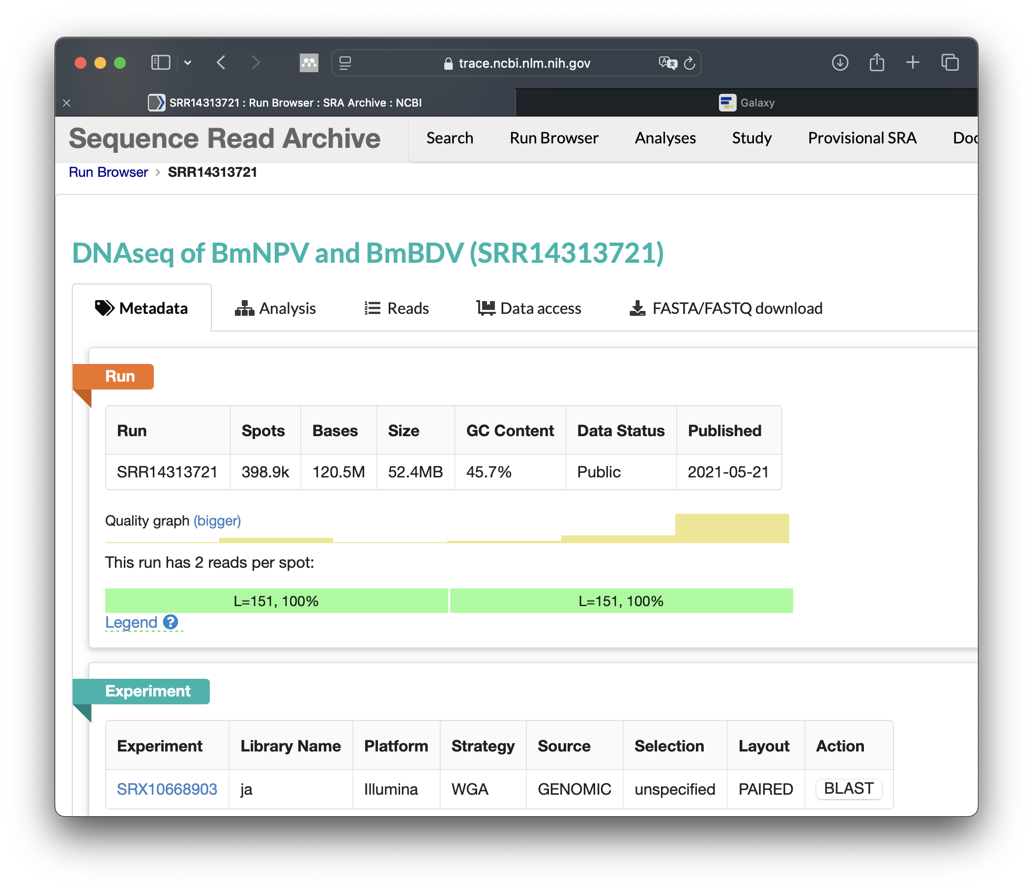
No. of sequenced bases and GC content
Quality information
Read length = 151 nt
Platform: Illumina
Paired reads: yes

Slide 14
Bases sequenced and GC content
Quality information!
Read length = 151 nt
Platform = Illumina; Paired = yes!

Slide 15

Click on Analysis

Slide 16
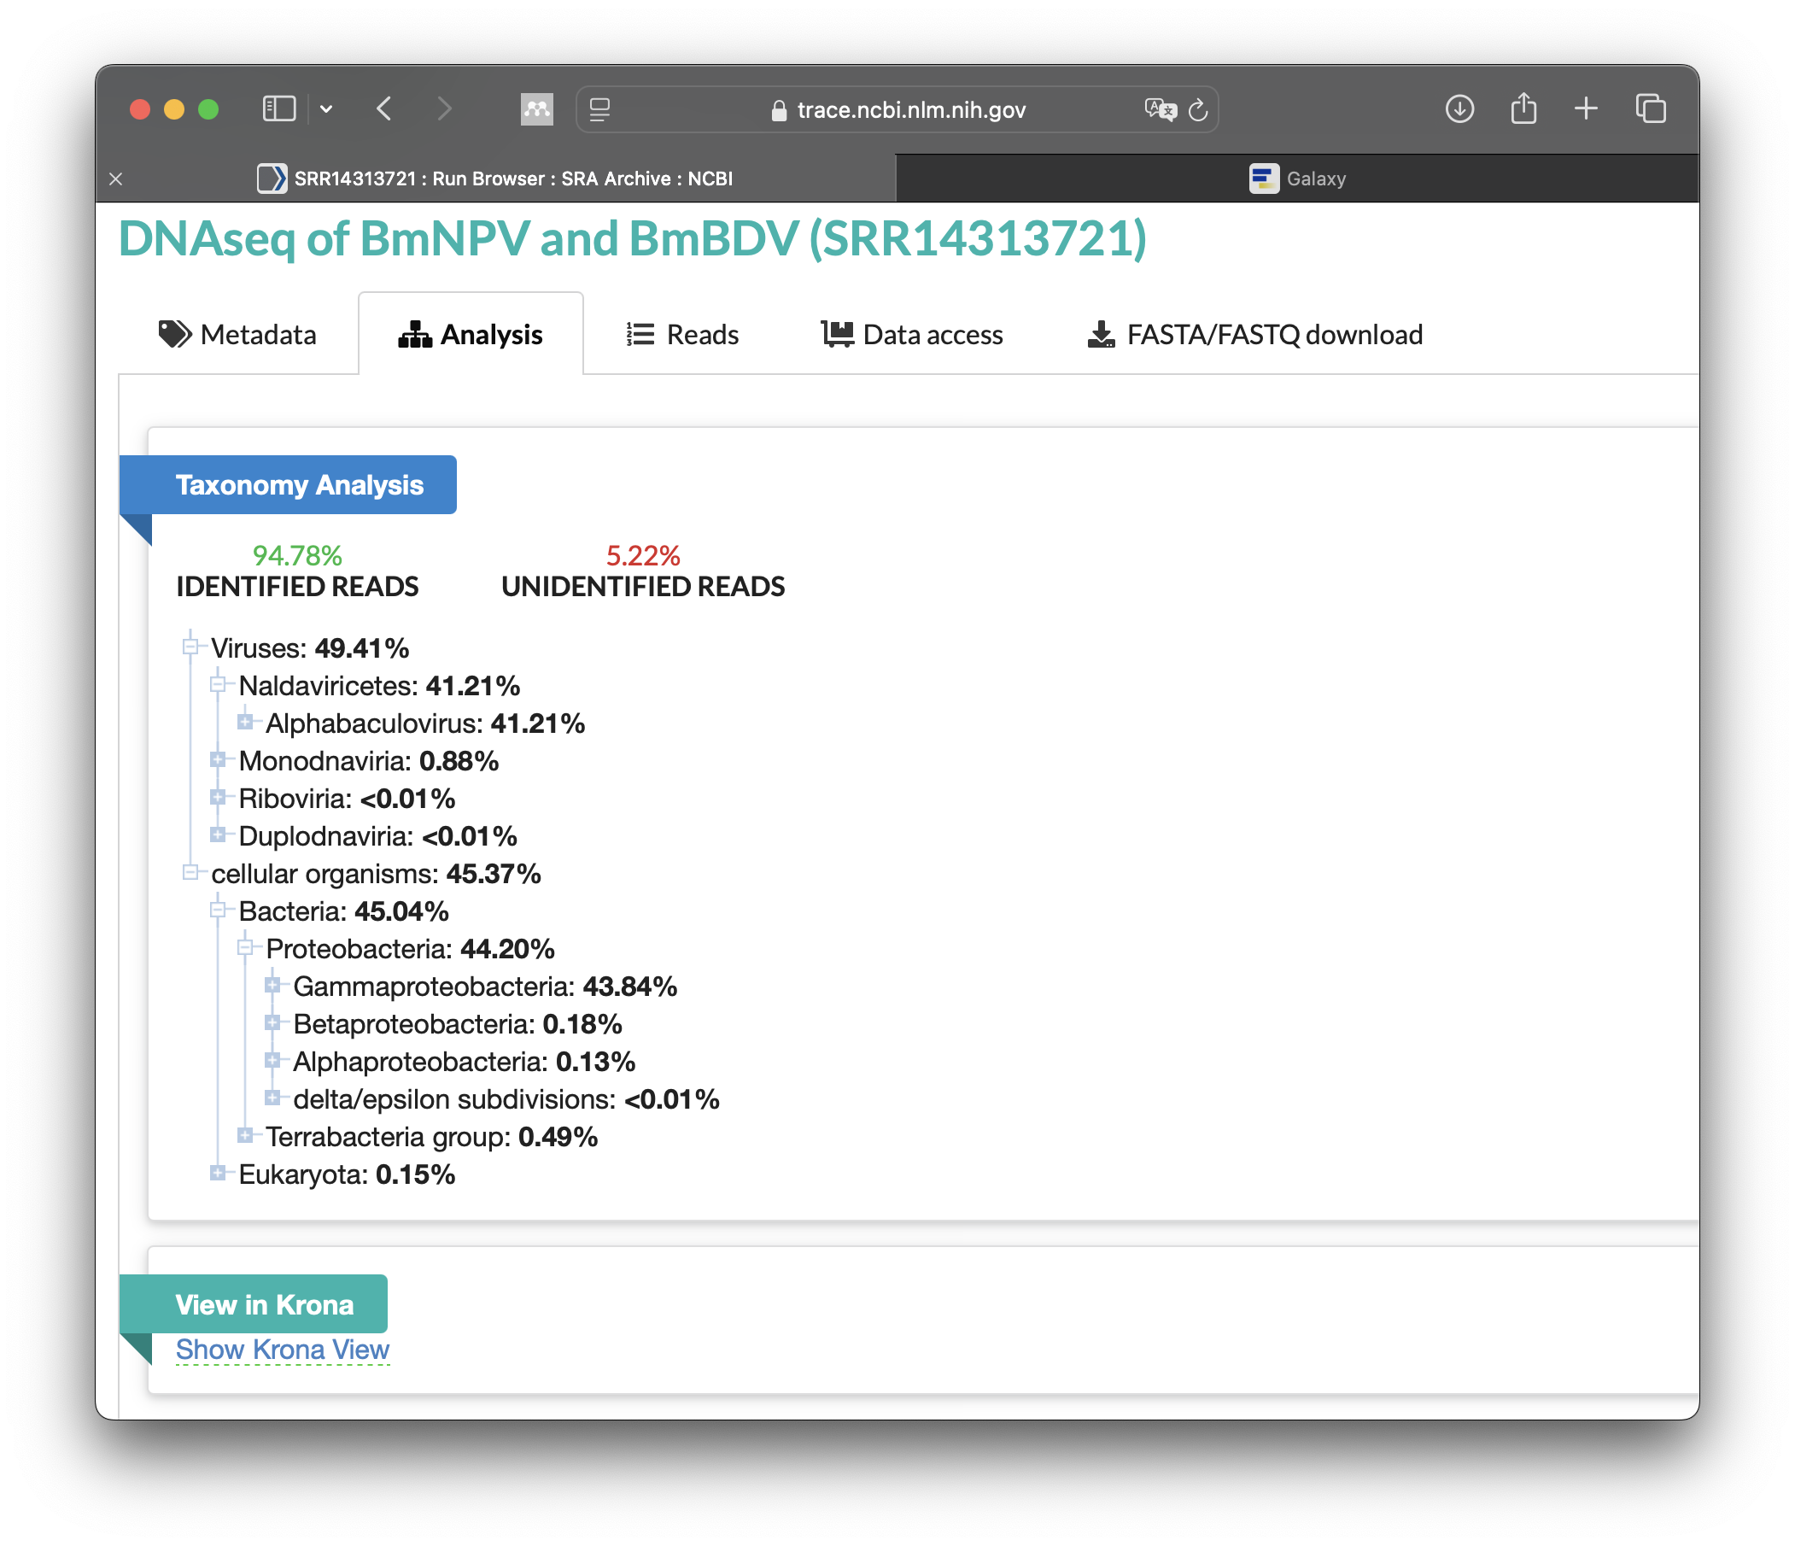

Slide 17
Click on „View in Krona“

Slide 18
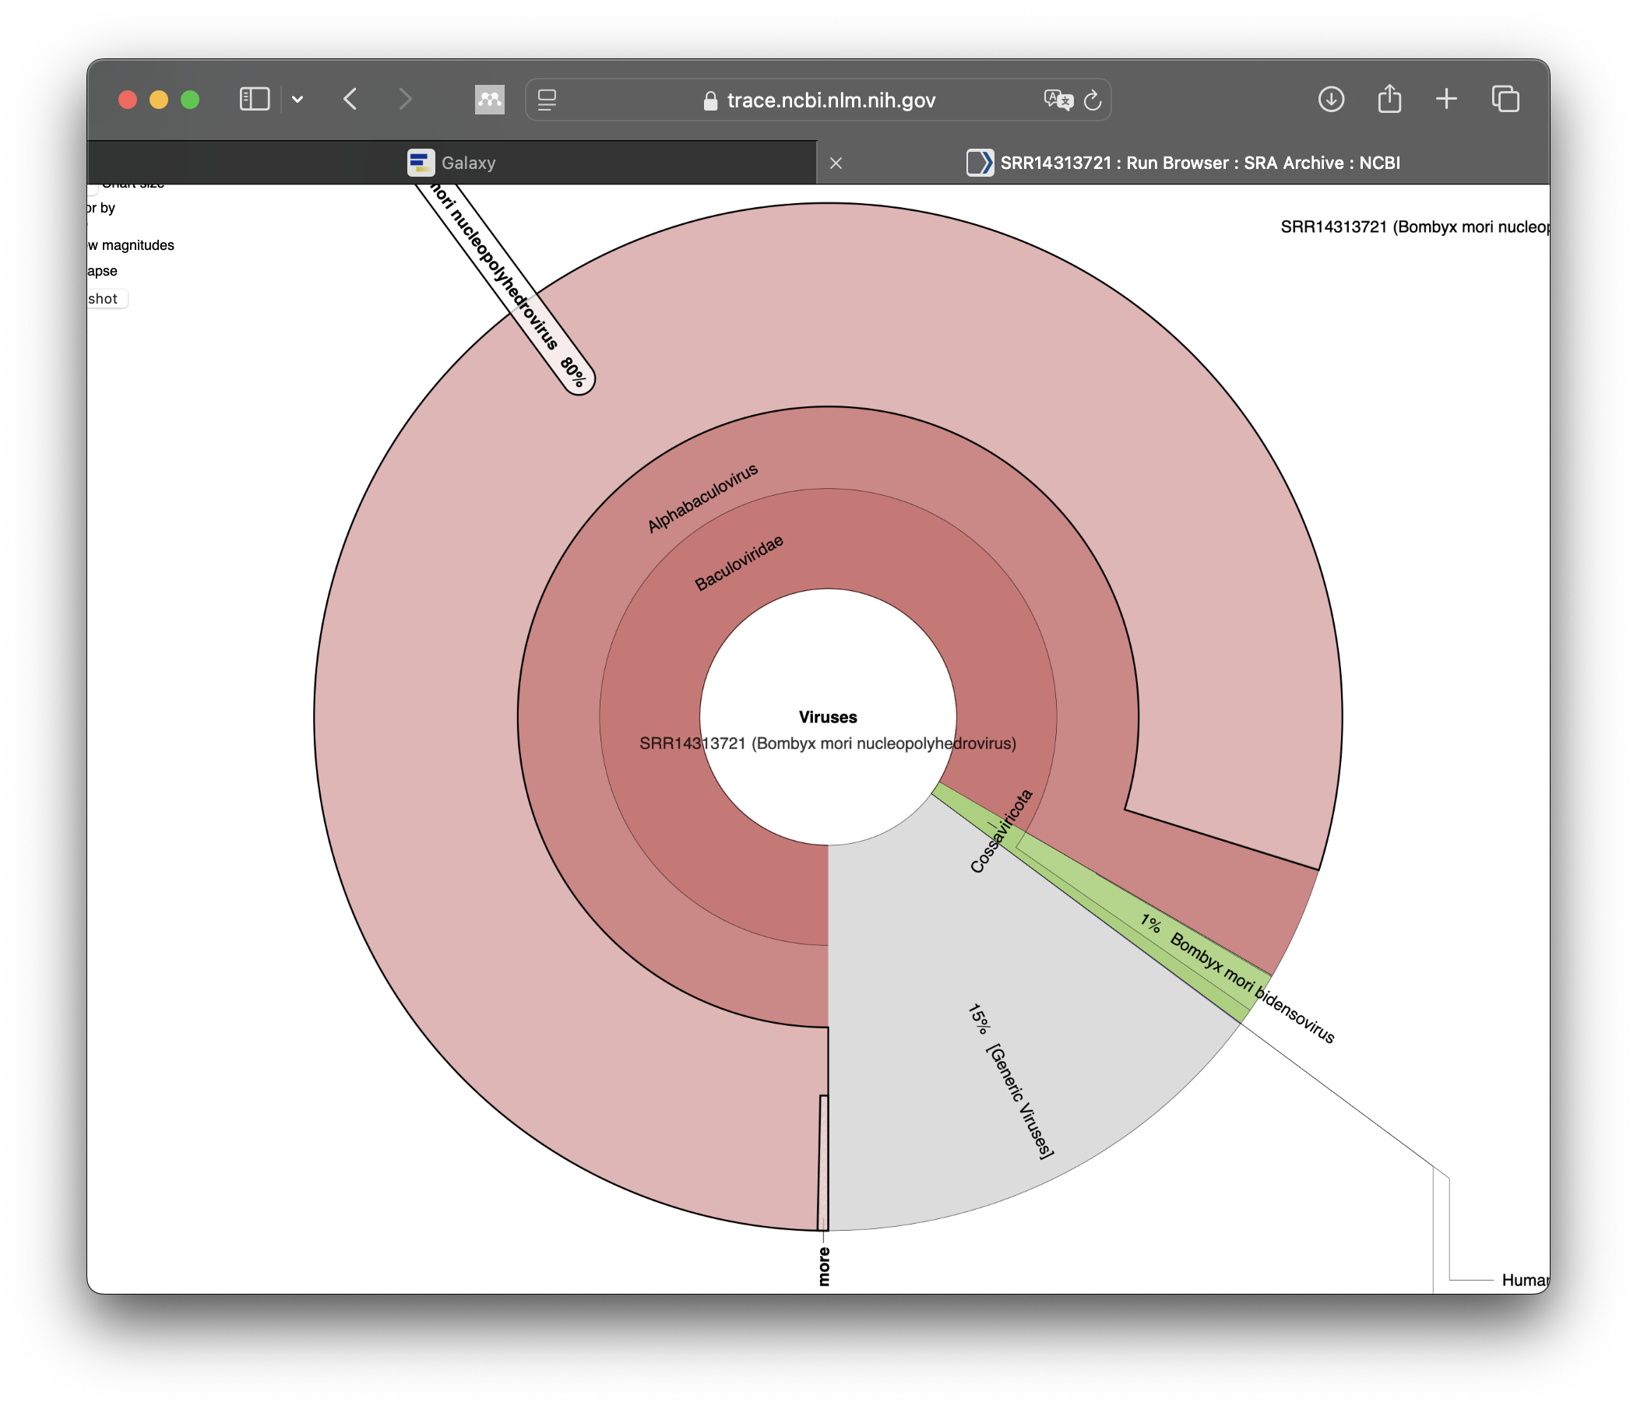
Enjoy your first interactive metagenomic analysis!
Tomorrow you create this by yourself!

